Slide 1
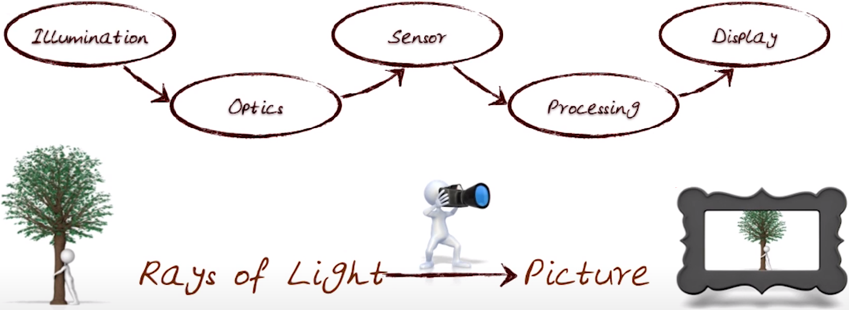

Multilevel Diffractive Optics in the landscape of Computational Photography
Sourangsu Banerji
Department of Electrical and Computer Engineering
University of Utah
10/26/2020
Notes:
Good evening and hello everyone! I guess by now all of you are aware of who I am and what I do but let’s just start with a formal introduction. My name is Sourangsu Banerji and I am finishing PhD student in the group. I mostly deal with doing computational stuff as you might all be already knowing and today, I am going to be talking about “Computational Photography”. This is something which encompasses my own PhD research and branches out into diverse fields of their own and which I wish to pursue sometime in the future if given the opportunity. As usual, my talk is not going to be extremely technical, but I will try to motivate you about how computation can influence the entire photography pipeline; right from the illuminating a 3D scene to capture a 2D image to finally rendering it on a display.
Let’s start!

Slide 2
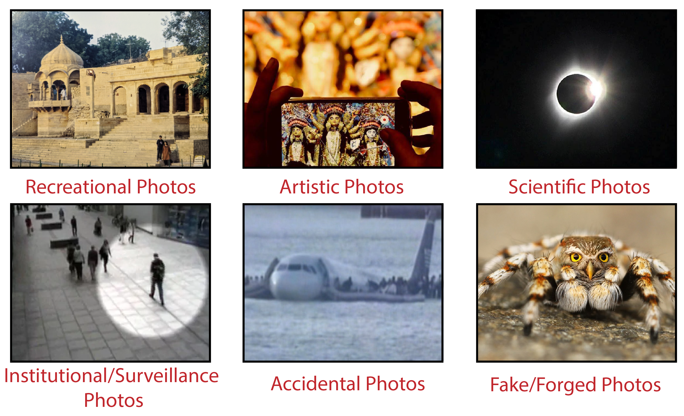
Photography
Photography: the art of taking or processing “photos”
Notes:
Photography in general refers to the art of taking or processing photos. However, when I say “photos” it can mean various different things or might actually refer to various different types of photos. They might be recreational photos where I am capturing my life’s memories….they might be artistic photos which I wish to sell in a marketplace and earn money….or even scientific photos where I am looking to gain information.
Surveillance photos to keep track of people’s movements….or purely accidental photos which in the first place were never meant to be taken but was captured by accident. Finally, there are also fake photos which a lot of times might be harmless or sometime even be harmful when used against another person for blackmail.
But one thing is common in all of these photos ! That is they were captured or manipulated using a hardware device and a software.

Slide 3
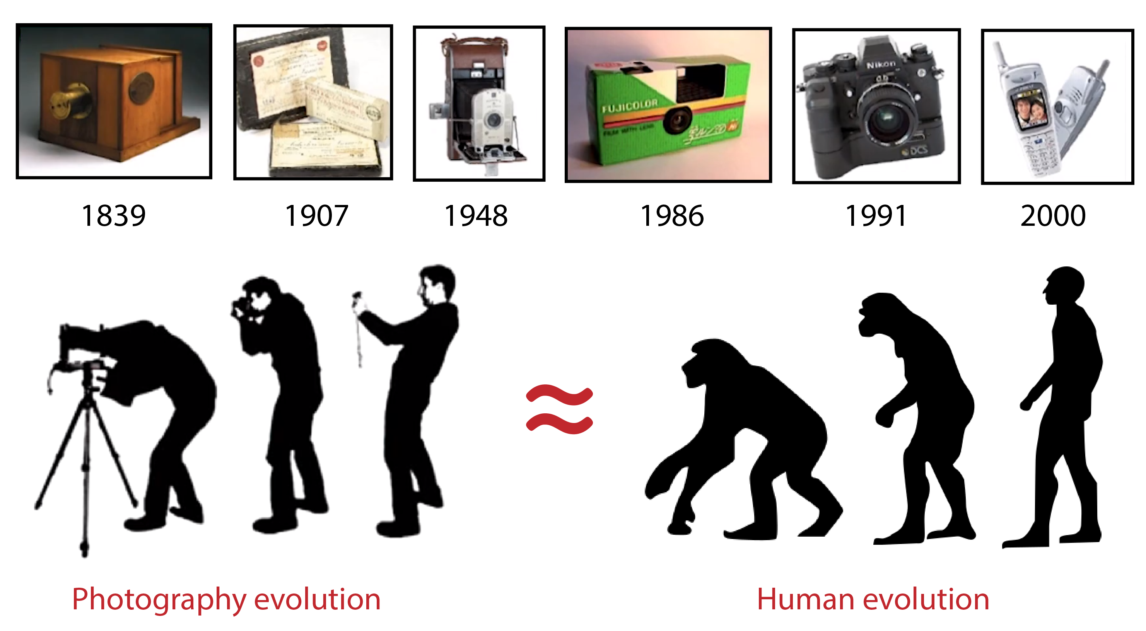
Camera & Photography
Notes:
Camera is that hardware device which technically captures a photo. As you can see from the top panel here; that camera in itself have come along a long way from being a bulky device to something which is small and portable.
With the advent of the SLR cameras back in 1986, the progress thereafter made in the field of photography has been monumental and right now everybody has a camera i.e. either a dedicated DSLR or a smartphone camera.
So much so, that a term “casual photography” is now being proposed to be added to the Merriam Webster dictionary. However, if I were to depict this progress on a pictorial scale, I would sum it up as the one shown in the bottom panel where one can see that this photography evolution closely resembles our very own Darwinian evolution. Haha!

Slide 4
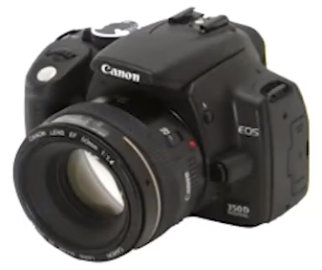
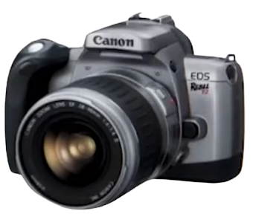
Computation & Photography
Film/Digital cameras (photography) have roughly the same features and controls:
More Light
Depth of Field
Zoom and Focus (Control over field of view)
Aperture and Exposure
Shutter release and Advance
One shutter press = One snapshot
Better optics
Notes:
Moving ahead, I am not going to go into the details of how these SLR or DSLR cameras work but just want to highlight some of the features of these awesome devices! Technically whatever it may be, for example a SLR or a DSLR, the features and the working principle are the same. For example, they can take in More Light to give sharp images, have Depth of Field, Zoom and Focus (Control over field of view) at various points in the 3D scene, manually control the Aperture and Exposure in accordance to the Shutter release and Advance, One shutter press = One snapshot, with all of this being facilitated by better optics.

Slide 5

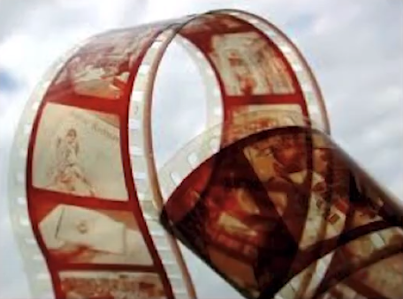
Computation & Photography
Computational photography extends film/digital photography by allowing us to
Change the optics, illumination, sensor, movement
Exploit wavelength, speed, depth, polarization etc.
Employ network of static cameras
Dynamic range within a small form factor (er. Smartphones)
Vary focus point-by-point in a small packaging
Field of View v/s Resolution
Exposure time and frame rate
Burst photography
Notes:
Now adding computation to this field of photography in essence does not replace anything; rather it extends upon the existing capabilities of traditional photography by allowing us to perform all exciting stuff in a small form within the palm of our hand.
I am not going to over all the points in details but essentially it now allows us to play with the optics, illumination, sensor, movement.
Exploit wavelength, speed, depth, polarization etc.
Employ network of static cameras
Dynamic range within a small form factor (er. Smartphones)
Vary focus point-by-point in a small packaging
Field of View v/s Resolution
Exposure time and frame rate
Burst photography

Slide 6
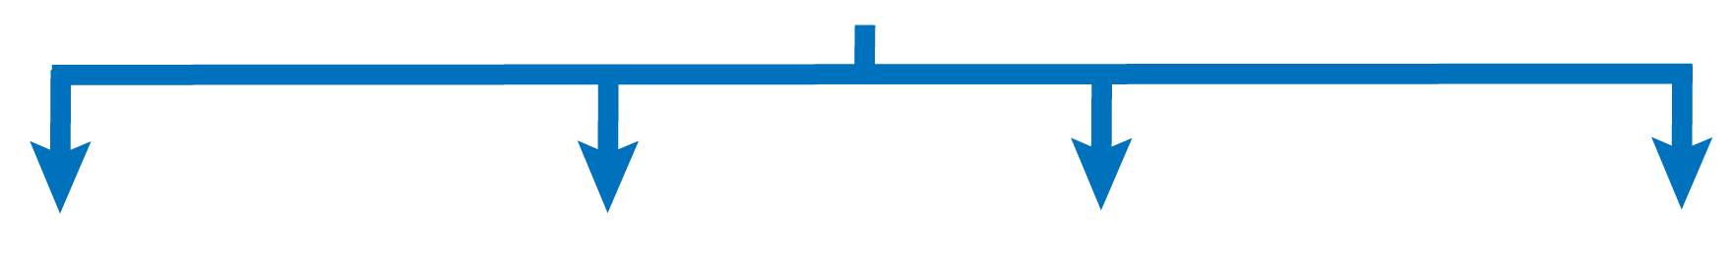
Computational Photography
Computational Photography
Computer
Vision
Computer
Graphics
Image
Processing
Optics/
Sensors
Optics
Images (2D)
Geometry (3D)
Shape
Photometry
Appearance
Sensors
Notes:
In principle, computational photography can be sub-divided into four major sub-categories which are again a field of their own i.e. computer vision, computer graphics, image processing and finally optics/sensors. My own PhD research dealt extensively with this last category.
If asked to represent this entire field of computational photography with a simple block diagram, it would look something like what is shown in the bottom panel.

Slide 7
Computational Photography
Computational Photography
Computer
Vision
Computer
Graphics
Image
Processing
Optics/
Sensors
Optics
Images (2D)
Geometry (3D)
Shape
Photometry
Appearance
Sensors
Notes:
Now let us see how all of these sub-fields fit into this puzzle.
Computer vision is really about trying to take imagery of the real world and infer things like what's the geometry of it and also the appearance and photometric inferences of this thing. So basically from 2D world we're trying to infer more things about the 3D scene.

Slide 8
Computational Photography
Computational Photography
Computer
Vision
Computer
Graphics
Image
Processing
Optics/
Sensors
Optics
Images (2D)
Geometry (3D)
Shape
Photometry
Appearance
Sensors
Notes:
Computer graphics on the other hand is about taking this kind of stuff and generating nice 3D images. This in principle is the inverse of computer vision.

Slide 9
Computational Photography
Computational Photography
Computer
Vision
Computer
Graphics
Image
Processing
Optics/
Sensors
Optics
Images (2D)
Geometry (3D)
Shape
Photometry
Appearance
Sensors
Notes:
Imaging processing is the field to enhance the quality of images i.e. producing better quality images. It also gives us information.

Slide 10
Computational Photography
Computational Photography
Computer
Vision
Computer
Graphics
Image
Processing
Optics/
Sensors
Optics
Images (2D)
Geometry (3D)
Shape
Photometry
Appearance
Sensors
Notes:
optics and sensors help us to design better sensors and displays and the kind of information that we want to capture from the environment i.e. our 3D scene.
All of these four, computer vision, computer graphics, image processing, and optics and sensors are popular field of their own and computational photography leverages all of them.

Slide 11
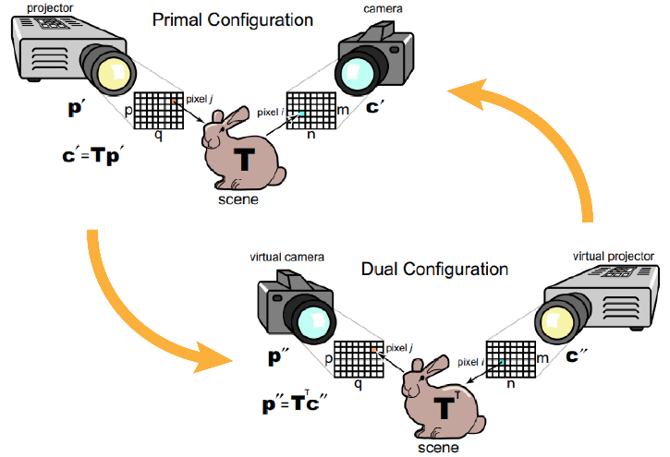
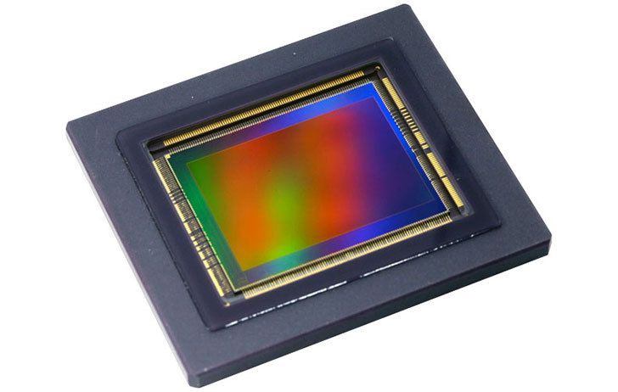
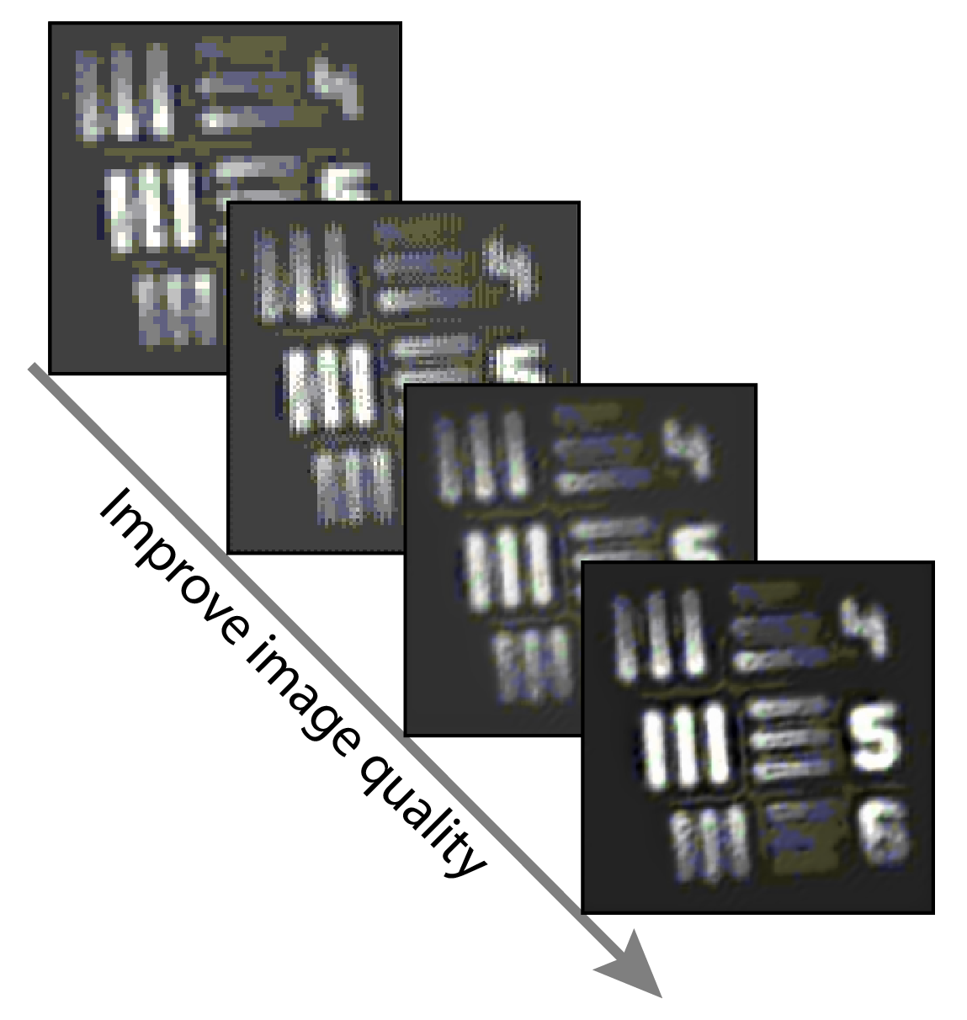
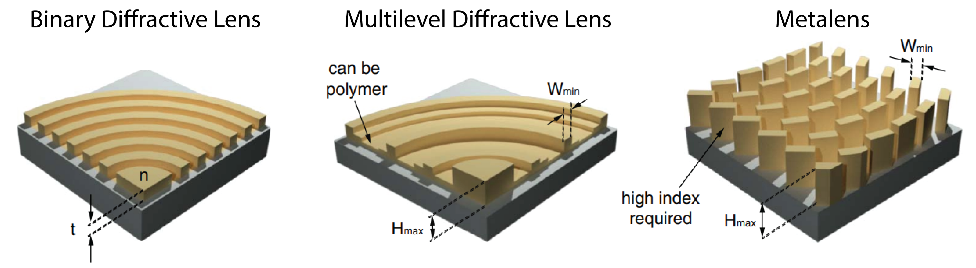
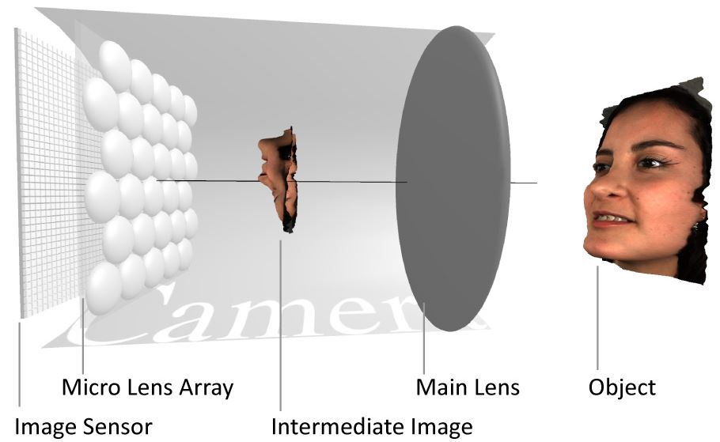
Outline
Notes:
This brings us to the outline of my talk today where my goal (to an extent) is to educate you about this entire computational photography pipeline as well as to highlight what I and my team have achieved till date along this entire pipeline starting with illumination right up to display without really going into deep discussions of anything related to its underlying fields of computer vision, computer graphics, image processing or optics.
You will notice as I will go through my talk how complicated yet “simple” it is to render an aesthetically “beautiful” image!

Slide 12
Outline
Notes:
Let’s us start with illumination and see how computation affects its.

Slide 13
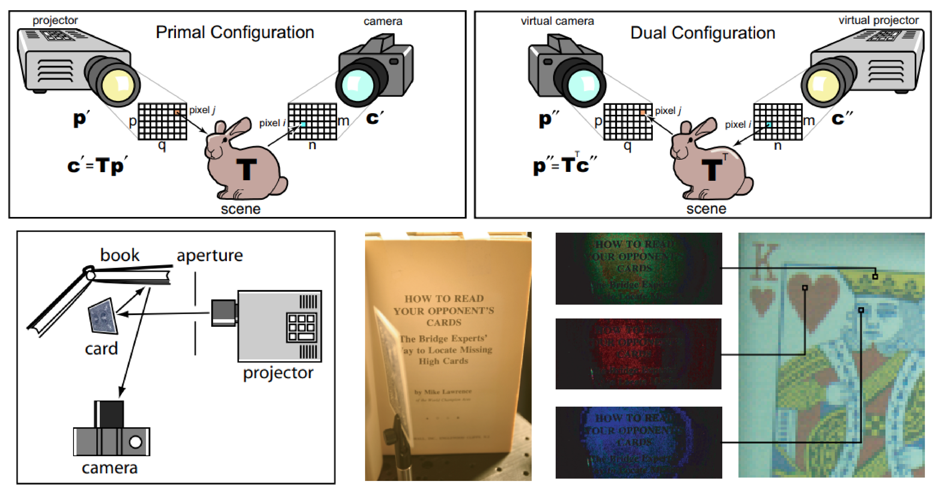

Dual Photography
One can generate a
“novel” image
Clever application of Helmholtz reciprocity!
[1] P. Sen et.al., SIGGRAPH, 2005.
Notes:
The sub-field of “dual photography” speaks about how one could change/control the illumination of a 3D scene to generate a “novel” 2D image. By “novel” I mean an image which is computationally rendered or rather inferred from the taken image.
How this is achieved is interesting and let’s hear it from the authors themselves!

Slide 14

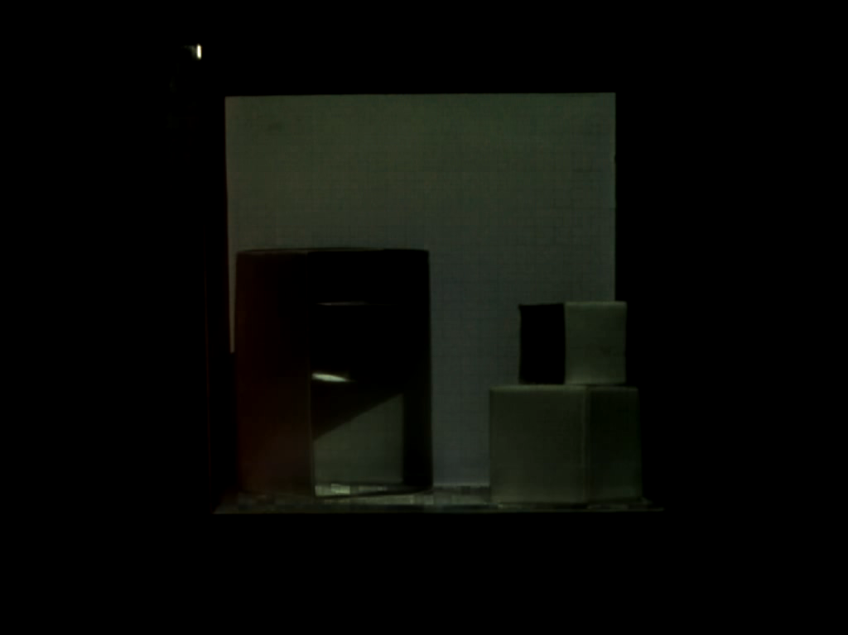
Dual Photography
[1] P. Sen et.al., SIGGRAPH, 2005.
Notes:
The top panel shows a simple experiment which was performed but let’s this experiment in live action !
Apart from this another interesting experiment was also performed by the authors.

Slide 15
Dual Photography
Key takeaway: By playing around with illumination, one can now generate novel images.
[1] P. Sen et.al., SIGGRAPH, 2005.
Notes:
So the key takeaway here is that By playing around with illumination and an adaptive computational algorithm, one can now generate novel images and see things which was previously not possible.
We personally have not looked into this segment of the computational photography pipeline as of now.

Slide 16
Outline
Notes:
This next section is where my own personal PhD research plays a big part i.e. to come with up with optical components which can now reduce the overall weight and form factor of a camera device!

Slide 17
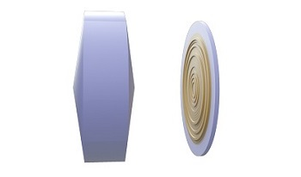
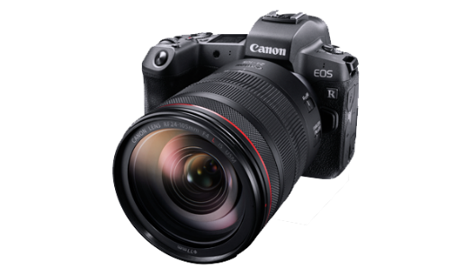
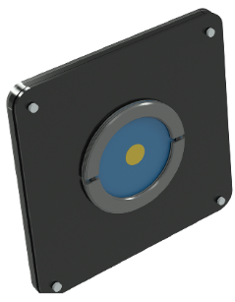
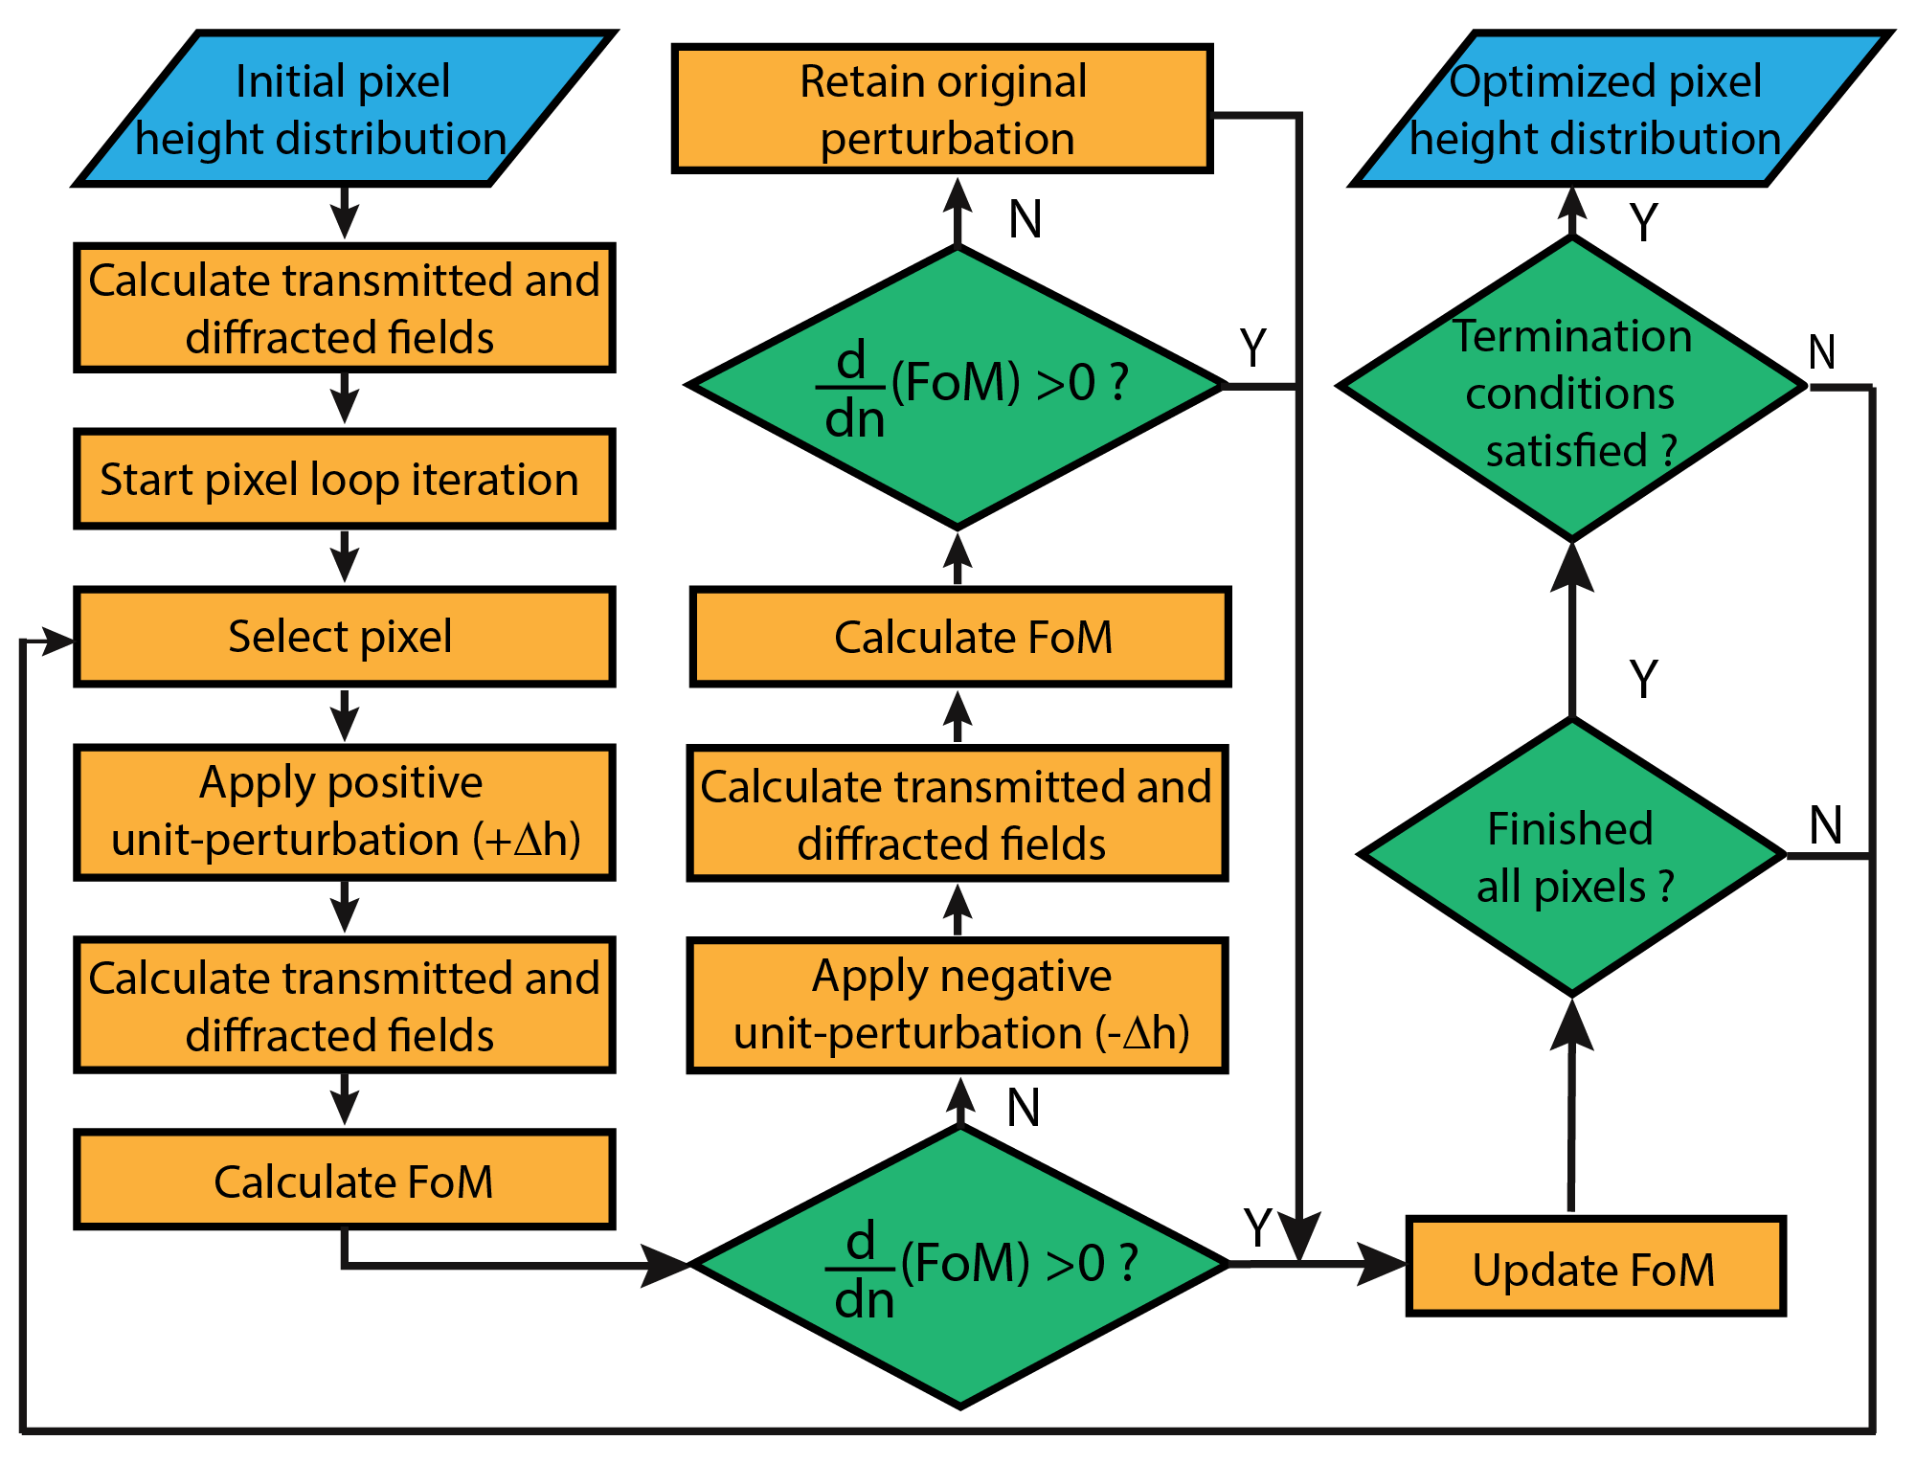
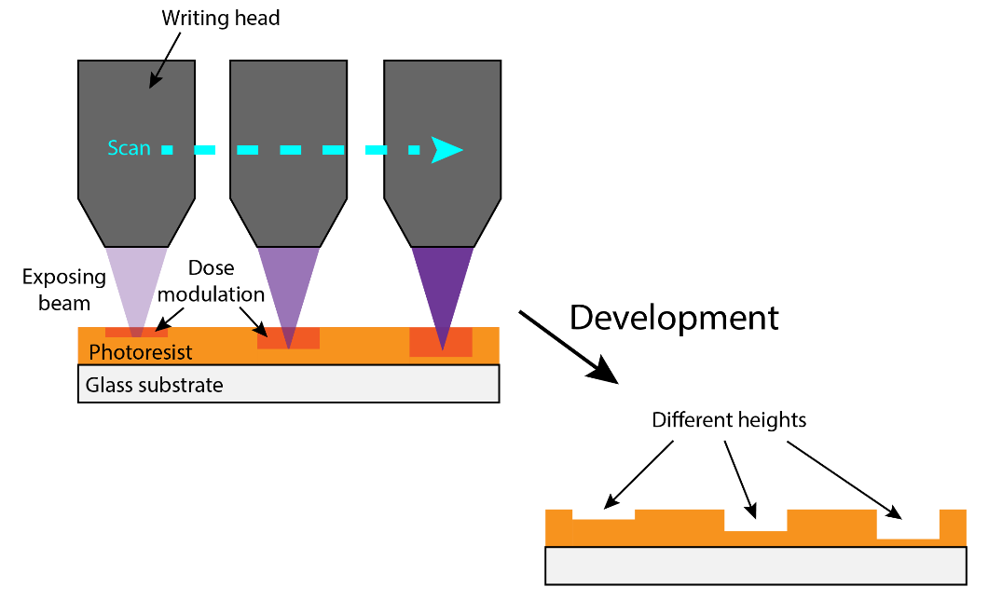
Inverse Designed Multilevel Diffractive Lens (MDL)
Simulation
Fabrication
Optimization Algorithm
Grayscale Photolithography
[1] S. Banerji et.al., Scientific Reports, 6(6), 2019.
Notes:
The goal here to replace a conventional refractive lens as shown here with an equivalent flat and thin diffractive lens so as to reduce the overall foot print of my camera as is shown here.
Again as one can see that these diffractive lenses can now be computationally inverse designed with an algorithm and fabricated with a grayscale photolithography technique.

Slide 18
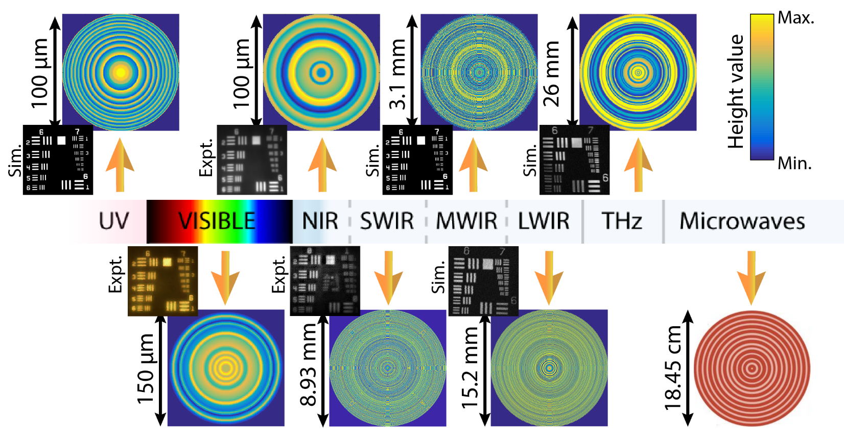
Multilevel Diffractive Lens (MDL) and the EM spectrum
There is no issue of scalability!
[1] S. Banerji et.al., Scientific Reports, 6(6), 2019. [2] M. Meem, S. Banerji et.al., PNAS, 6(6), 2019.
[3] S. Banerji et.al., Optica, 6(6), 2019. [4] S. Banerji et.al., OSA Continuum, 2(7), 2019.
Notes:
We showed that this approach could be generalized to design MDLs for any part of the electromagnetic spectrum and is not just limited to the visible wavelengths. As can be seen from the images here, the imaging is also at par (in terms of resolution) to the conventional lenses that one can find in the market.
But how do we quantify this in “real” numbers?

Slide 19
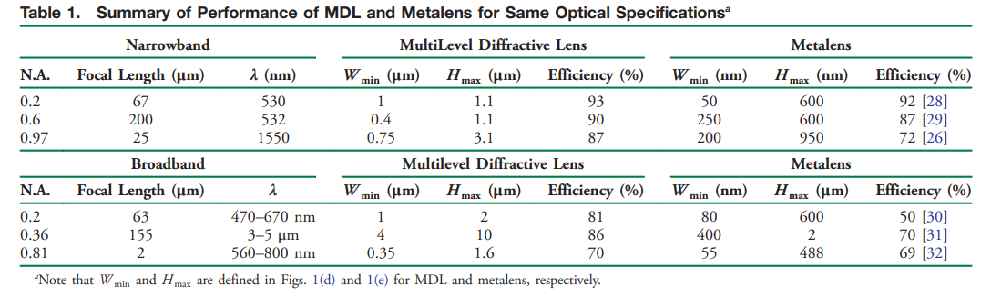
Why Multilevel Diffractive Lens (MDL) ?
[1] S. Banerji et.al., Optica, 6(6), 2019.
Notes:
To be honest, a real apples to apples comparison is impossible given the large lens market but even if we take the well known fact into consideration that a refractive lens focuses ~80% of the incident power into it focal spot, I want to highlight that the efficiency of our multilevel diffractive lens in almost all the cases can break that limit with considerable ease. In fact, it can even outperform the recent metalenses which has been touted as the next big revolution in lens design.

Slide 20
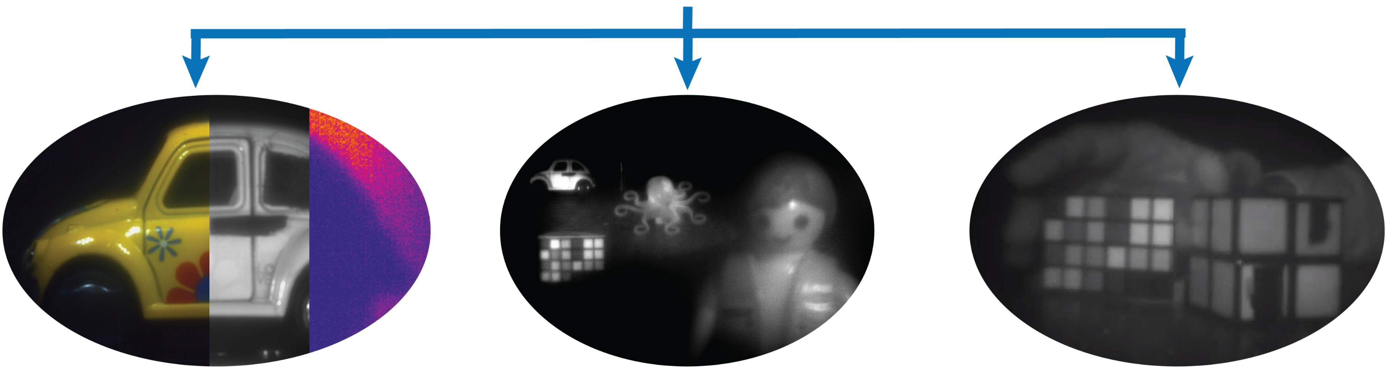
Multilevel Diffractive Lens (MDL) for Imaging
Achromaticity
Extended Depth of Focus
Wide Field of View
[1] S. Banerji et.al., Optica, 6(6), 2019. [2] S. Banerji et.al., Optica, 7(3), 2020.
[3] S. Banerji et.al., Optics Letters, 44(22), 2019.
Notes:
Now that we have established the fact that these inverse designed MDLs can truly perform to an extent on the scale on a conventional refractive lens, we targeted 3 most important lens parameters i.e. achromaticity, depth of focus and field of view and designed MDLs optimized for specific scenario and showcased imaging for each of them.

Slide 21
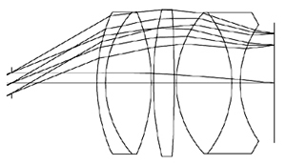
Refractive Lens
Is everything lost for refractive optics?
Erfle eyepiece
3D view
[1] S. Banerji et.al., (manuscript under preparation).
Notes:
But again another question which comes up now more often than before is that “Is everything lost for refractive optics?”. With the current claims of replacing these bulky refractive lenses with either MDLs or metalenses, will our labs altogether throw out the conventional stuff.
Well, not exactly! Keeping all this hype aside….there is still a lot of scope of research in refractive lenses too. As you can see, I recently came across this awesome software by the name of Code V and started doing innovative eyepiece designs.
As you all can see, that a conventional “erfle” eyepiece consists of 5 surfaces to perform a full 60 field of view imaging, my design does that with 4 surfaces with the same performance. This is where I feel where the refractive lens is heading too….. i.e. reducing the number of refractive lens components…which in principle can still be done….

Slide 22
Refractive Lens
Key takeaway: By reducing the weight of overall optics, one can now reduce the overall size of camera itself.
Is everything lost for refractive optics?
Erfle eyepiece
3D view
[1] S. Banerji et.al., (manuscript under preparation).
Notes:
But coming back to our main topic of discussion, the key takeway from this section is that By reducing the weight of overall optics, one can now reduce the overall size of camera itself.

Slide 23
Outline
Notes:
This next section is again another area whether neither me nor my group has really worked on but still for the sake of completeness, I will over it briefly. You will see that this is one area which is often neglected but has fetched the most Nobel prizes!

Slide 24
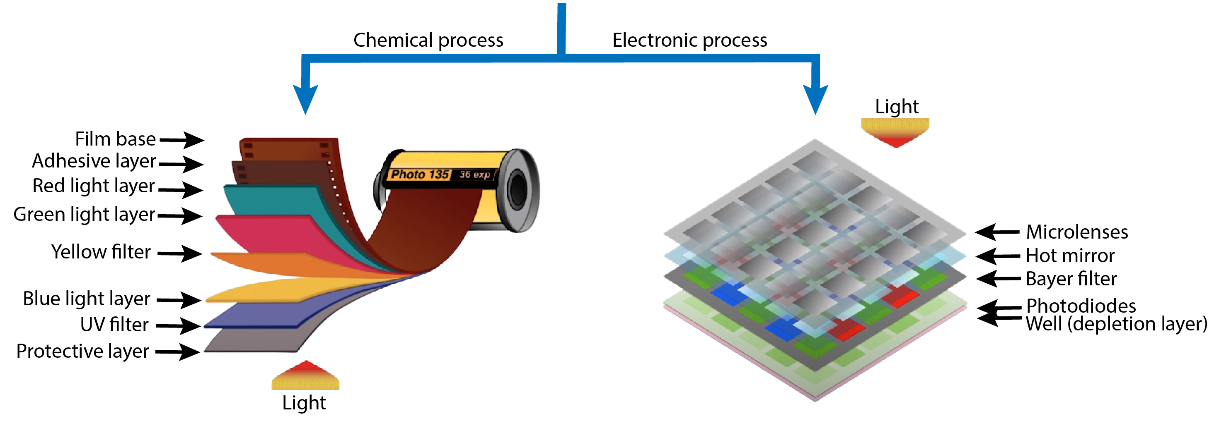
Sensors: Film v/s Digital
Camera Sensor
Film cameras
(Film rolls)
Digital cameras
(CCD/CMOS)
[1] J. Dubois et.al., IEEE Journal of Solid State Circuits, 43(3), 2008.
Notes:
Once the illumination strikes the object and hits the optical components in my camera, the next step in this process is to somehow direct this light into a media which can record this. A camera exactly does this job.
Now again, be it a film or a digital camera, this process of recording is more or less the same. For film cameras , one uses a 135mm camera roll whereas the digital cameras uses CCD/CMOS. I encourage you to learn more about the specifics of each of this technique in the following references.
However take note of this red highlighted part! We will come back to that in a second.

Slide 25
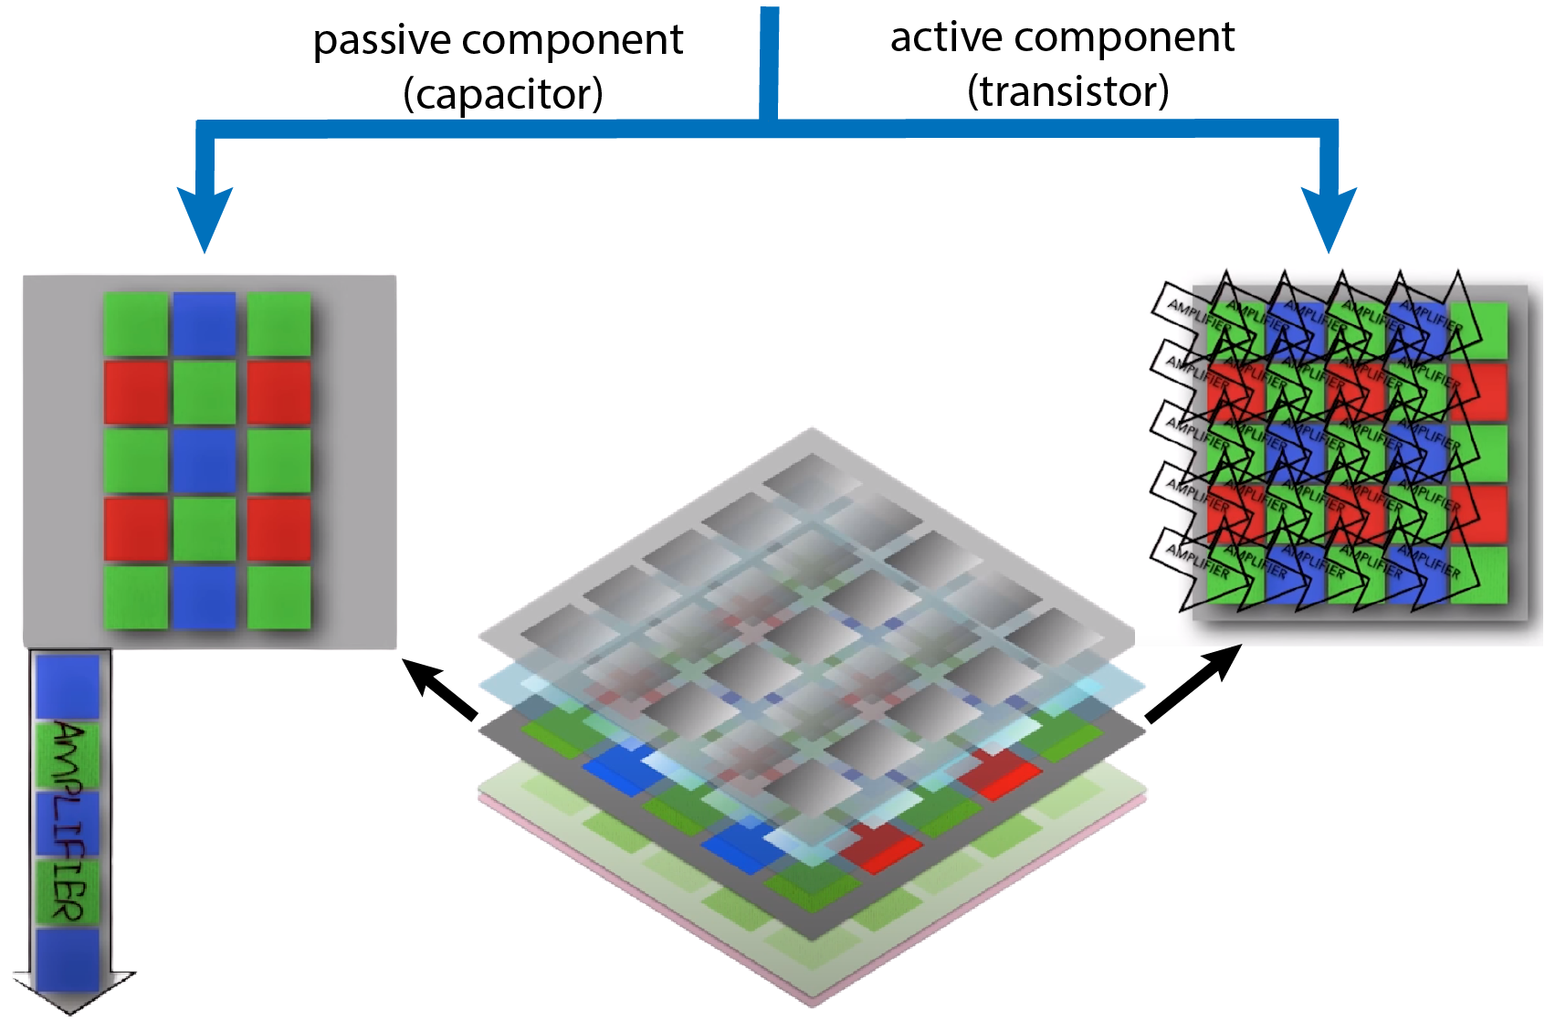
Sensors: CCD v/s CMOS
Digital Camera Sensor
Problem:
Rolling Shutter Effect
CMOS (Complimentary Metal Oxide
Semiconductor)
CCD (Charged Coupled Device)
[1] J. Dubois et.al., IEEE Journal of Solid State Circuits, 43(3), 2008
Notes:
A digital camera sensor is again sub-divided into 2 categories i.e. CCD and CMOS depending on how the information is stored and processed. CMOS sensors are cheap but a major problem with CMOS sensors is the rolling shutter effect. Again, I am not going to talk a lot about this issue but encourage you to look into the reference.

Slide 26
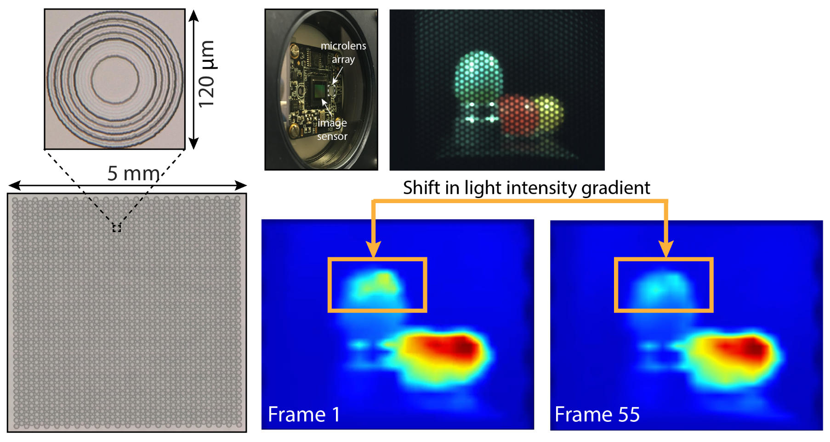
Better CMOS Sensors: A proposal
Advantages
Improved noise sensitivity
Better dynamic range
Better color representation
Notes:
A proposal here is too replace the top layer of microlenses which now consist of refractive components with MDLs for :

Slide 27
Better CMOS Sensors: A proposal
Key takeaway: With better quality camera sensors, one can now capture good quality of raw image data
Advantages
Improved noise sensitivity
Better dynamic range
Better color representation
Notes:
So, the key takeaway here is with better quality camera sensors, one can now capture good quality of raw image data.

Slide 28
Outline
Notes:
Finally, we come to the part where now computation plays a major role. You will see that most often than not the photos that your see nowadays on your digital screen looks very good compared to the photos which you have seen on these similar screens 10 years ago.
Apple and Samsung are coming out with better image quality camera phones each and every year. So, are they really re-inventing this field of photography every year over and over again?
The overall strategy to do photography remain the same with some basic advancement maybe in the optics design.
But the advancement right now is primarily made on the computation side which is enabling us to produce good quality images i.e. extracting out features from the image.

Slide 29
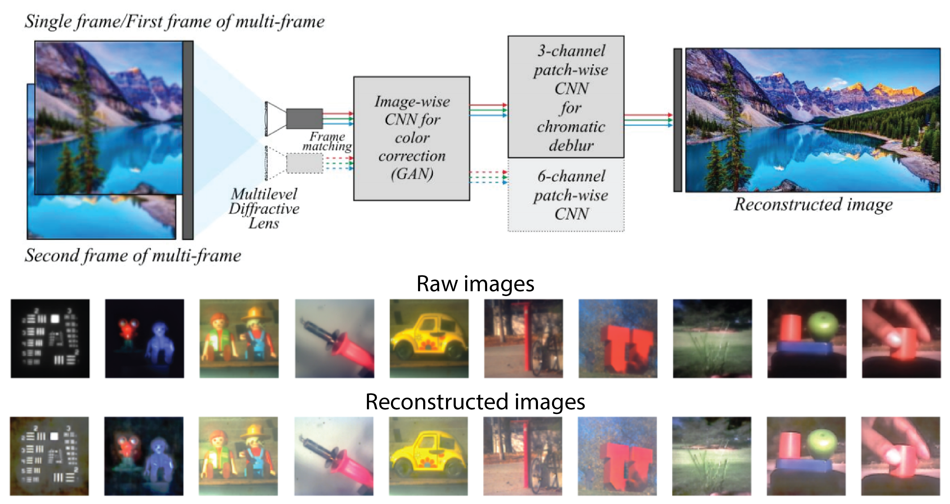
Deep Learning based Computational Imaging
[1] S. Banerji et.al., (manuscript under preparation).
Notes:
In this regard, me and my group are currently employing a deep learning (aka machine learning) based post-image processing pipeline to enhance the quality of the images.
I apologize that we still don’t really have good quality post-processed images as one can see from the bottom panel here which just shows that our trained model just learned to increase the brightness of the image.

Slide 30
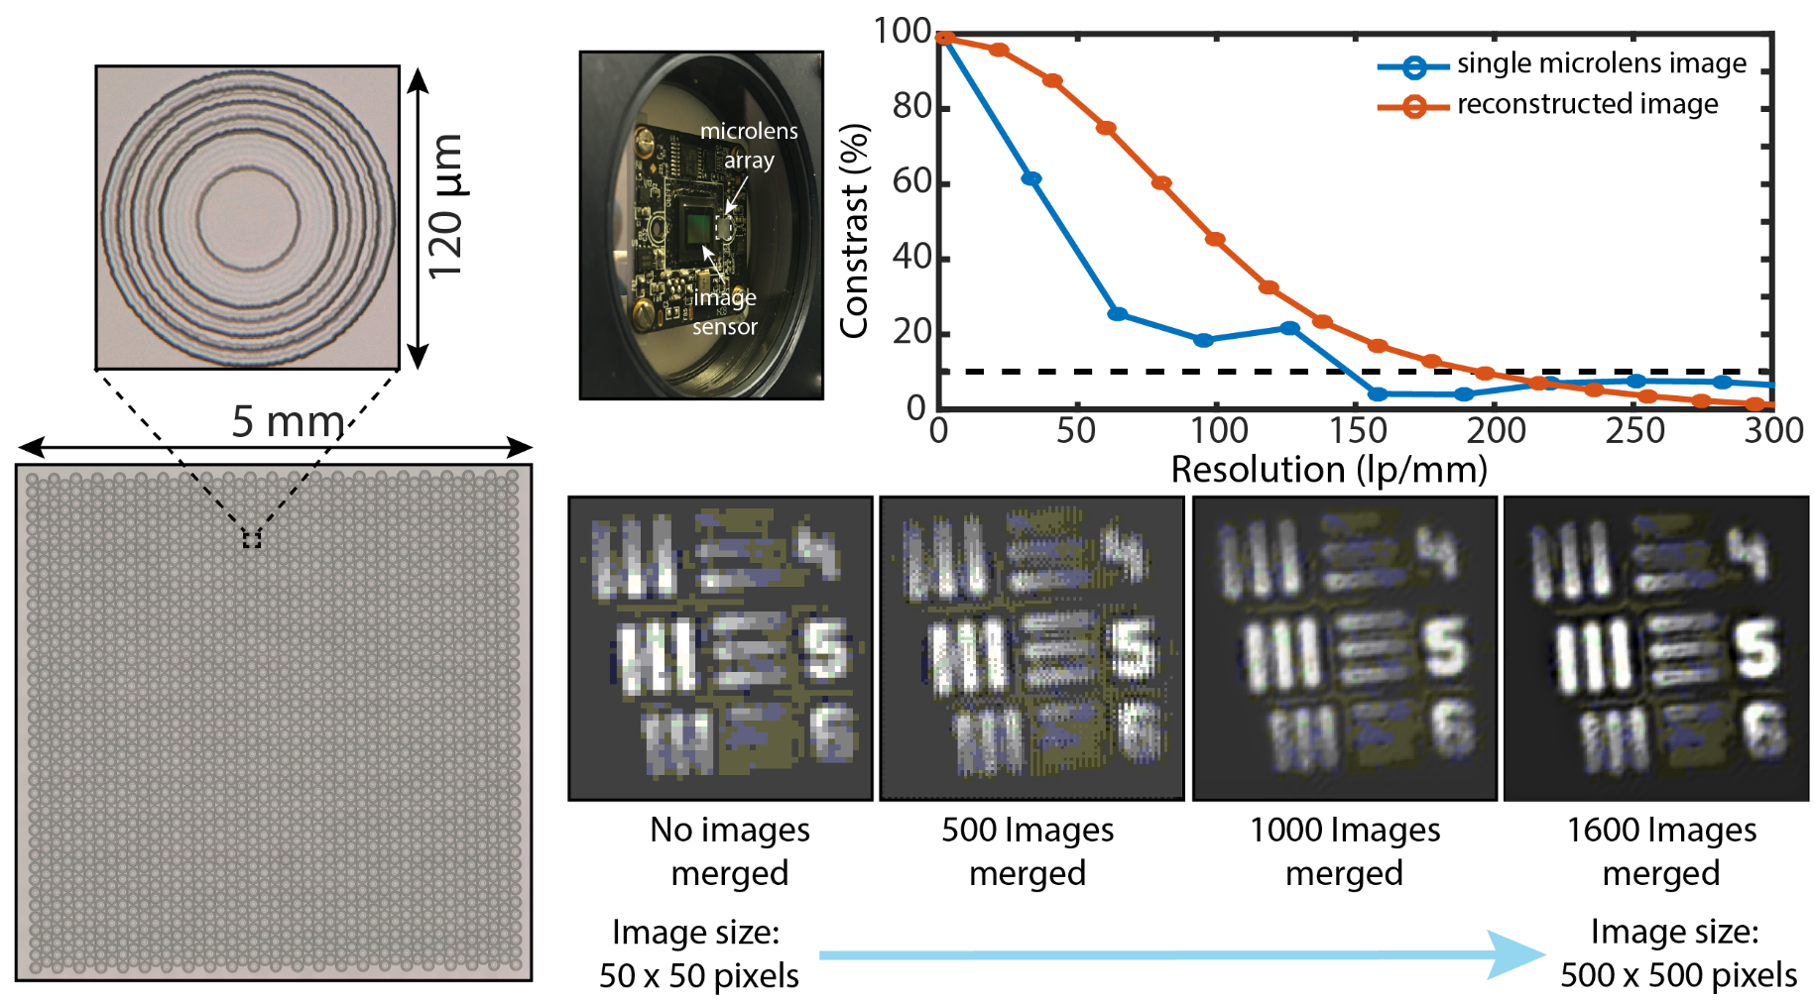
Super-resolution Imaging
[1] S. Banerji et.al., Optics Letters, 45(22), 2020.
Notes:
But we do really have some good results we tried out super-resolution imaging with a microlens array of our MDLs. You can see from this contrast plot as well visually perceive how we went about increasing the image size of the resolution chart with loosing out any information due to pixelation. In fact, the images have a better contrast. One can now make out these horizontal bars aside the figure 6.

Slide 31
Super-resolution Imaging
Key takeaway: By enabling post-processing imaging algorithms, one can now improve the overall quality of the image
[1] S. Banerji et.al., Optics Letters, 45(22), 2020.
Notes:
So the key takeaway here is that by enabling better post processing algorithms, one can now improve the overall quality of the raw captured images.

Slide 32
Outline
Notes:
The last section details with representing this set of high-quality images on a 2D or let’s say even a 3D scene i.e. incorporating depth!

Slide 33
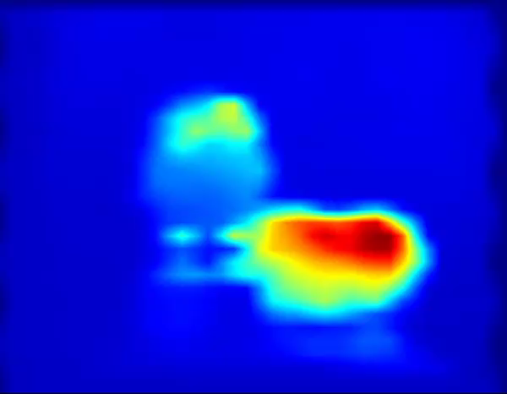
Light Field Imaging/Displays
[1] S. Banerji et.al., (manuscript under preparation).
Notes:
Our recent research effort in this area is to render 3D light field displays using microlens arrays. As you can see from the this video and these 2 images here that when this single image is slightly rotated from left to right, the light intensity across the frame changes. This ideally should give a 3D perspective.
This is might be a bit difficult to comprehend as the pixel resolution is so low and secondly because I am showing a 3D rendering on a 2D screen but efforts are currently underway to fix and improve upon this.

Slide 34
Light Field Imaging/Displays
Key takeaway: One can now extract additional information from an image
[1] S. Banerji et.al., (manuscript under preparation).
Notes:
The final key takeaway here is one can now extract additional information from an image, in this case, depth to render a 3D display from a 2D image with computational algorithms.

Slide 35
Outline
Notes:
By this time, I believe I have to an extent motivated you to look into this field of computational photography in some detail or even consider a career in it!

Slide 36
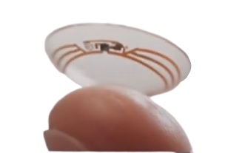

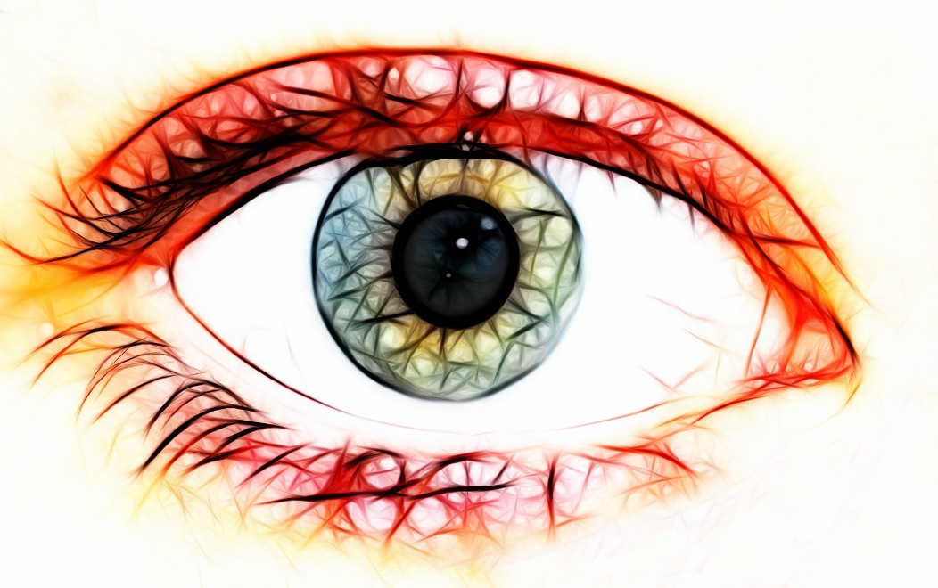
Final goals
1.What will a camera look like in the next 10 years? 20 years? How will the optics look like?
2. What novel images can we get? What will be their uses?
3. How will the next generation of cameras change our social culture?
4. How will ultra high-speed/resolution imaging change our usage?
Notes:
Now from the perspective of what I tend to achieve or see how this field will now evolve is 5 fold.

Slide 37

Thank you!

